Slide 1
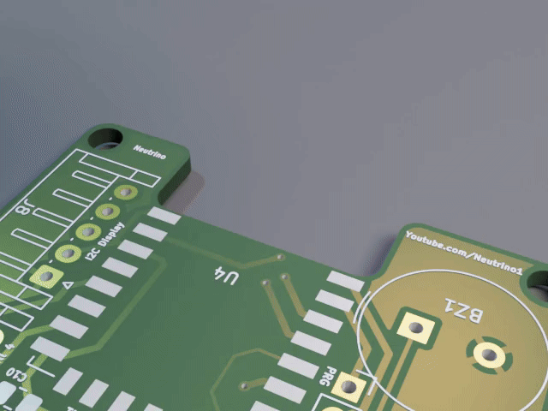

HARDWARE
DESIGN & MANUFACTURING

Slide 2
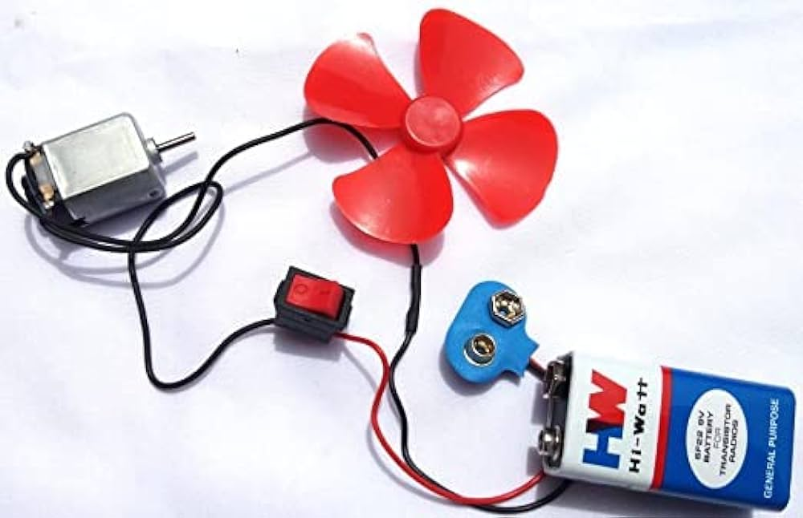
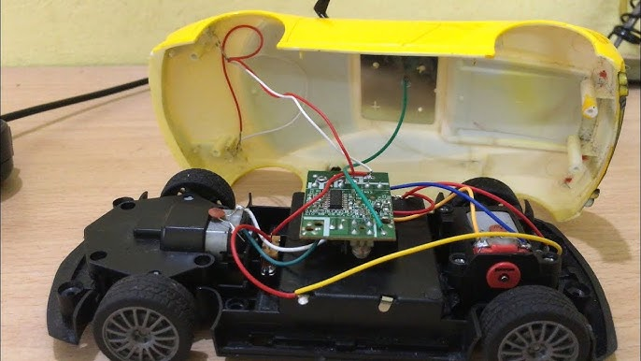
ME..

Slide 3
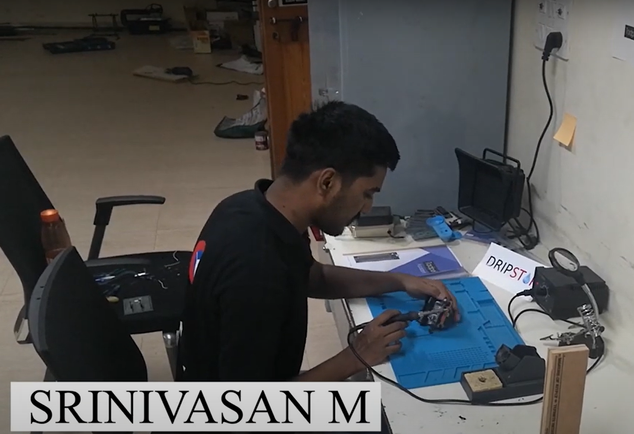



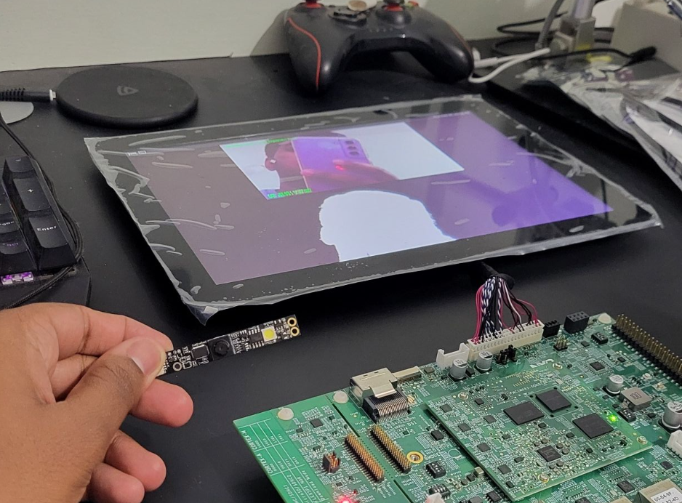

RESEARCH & DEVELOPMENT
PROTOTYPING & PRODUCT DESIGN
RAPID PROTOTYPING & MANUFACTURING

Slide 4

Building India’s largest
open source
hardware Ecosystem & Community!

Slide 5


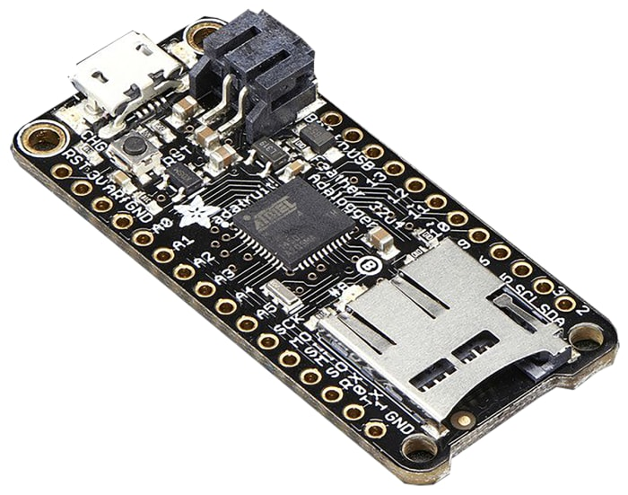
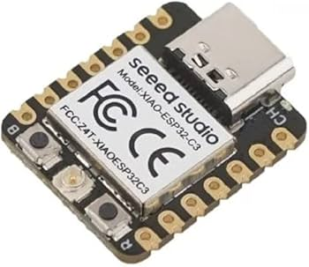
WHY PCBCUPID?

Slide 6
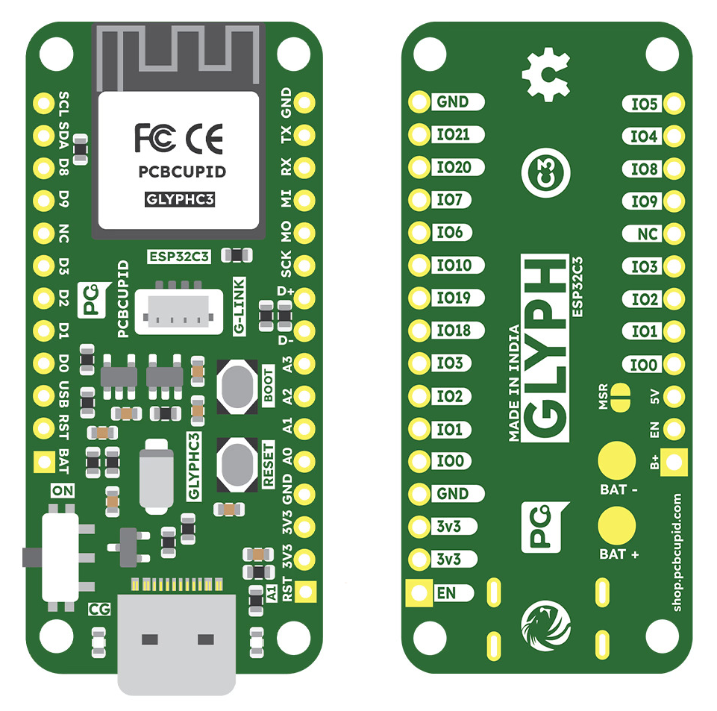
GLYPH – C3 / H2 / C6

Slide 7







AMPNICS

Slide 8
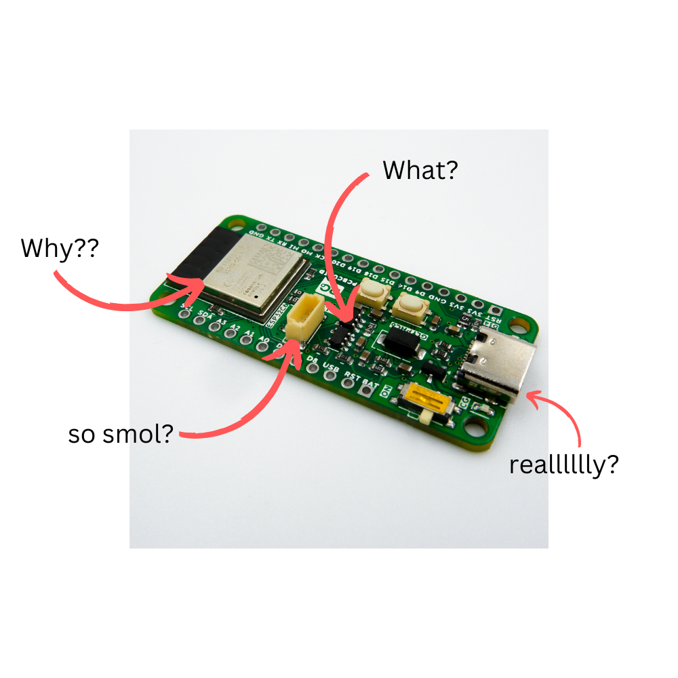

HARDWARE CASE STUDY
GLYPH

Slide 9
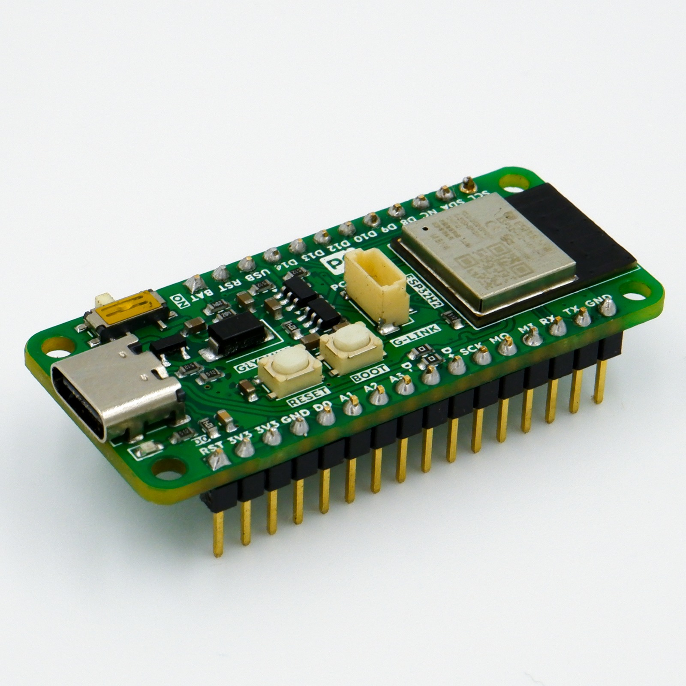
Product Goal
MAKE IN INDIA
EASY TO USE
HIGHLY DOCUMENTED!
OPEN SOURCE
Competitive Pricing

Slide 10
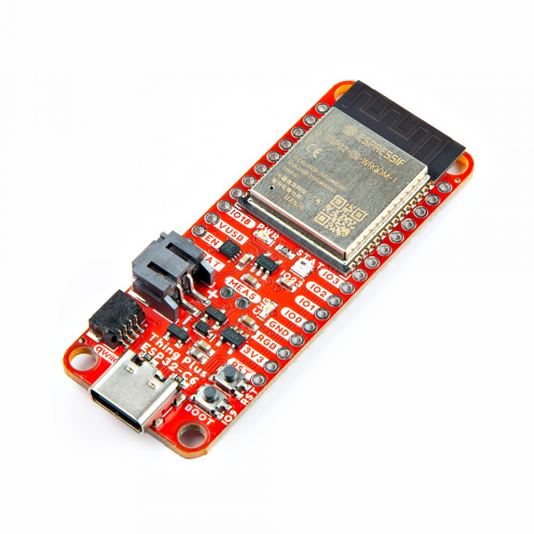
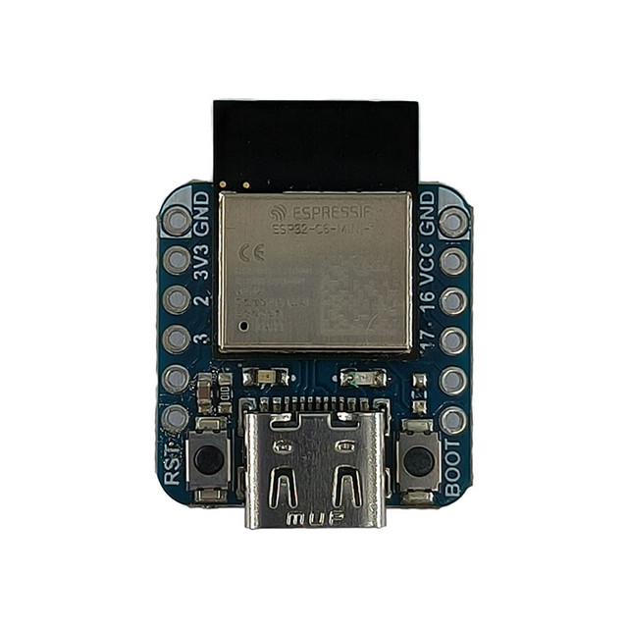
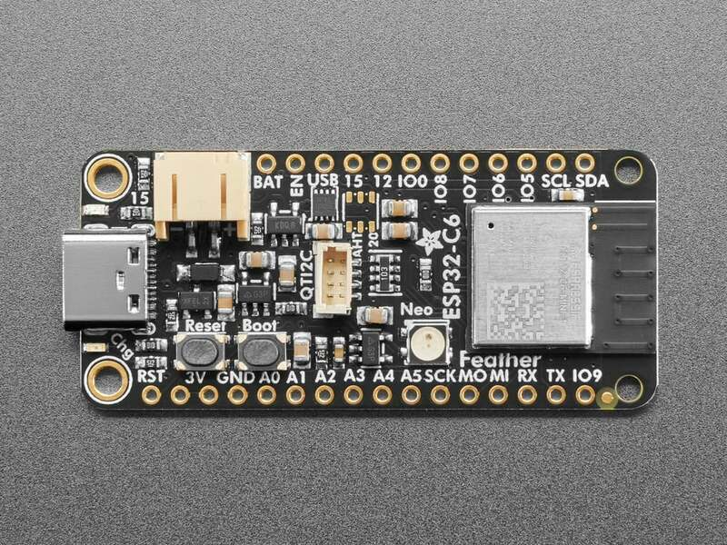
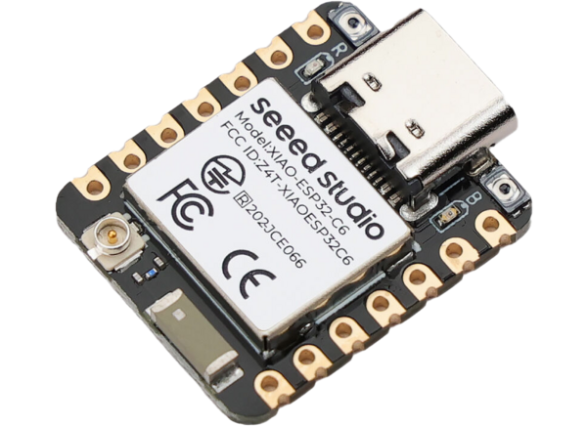

Competitor Study
~ 1800
~ 2000
~ 533
~ 643

Slide 11
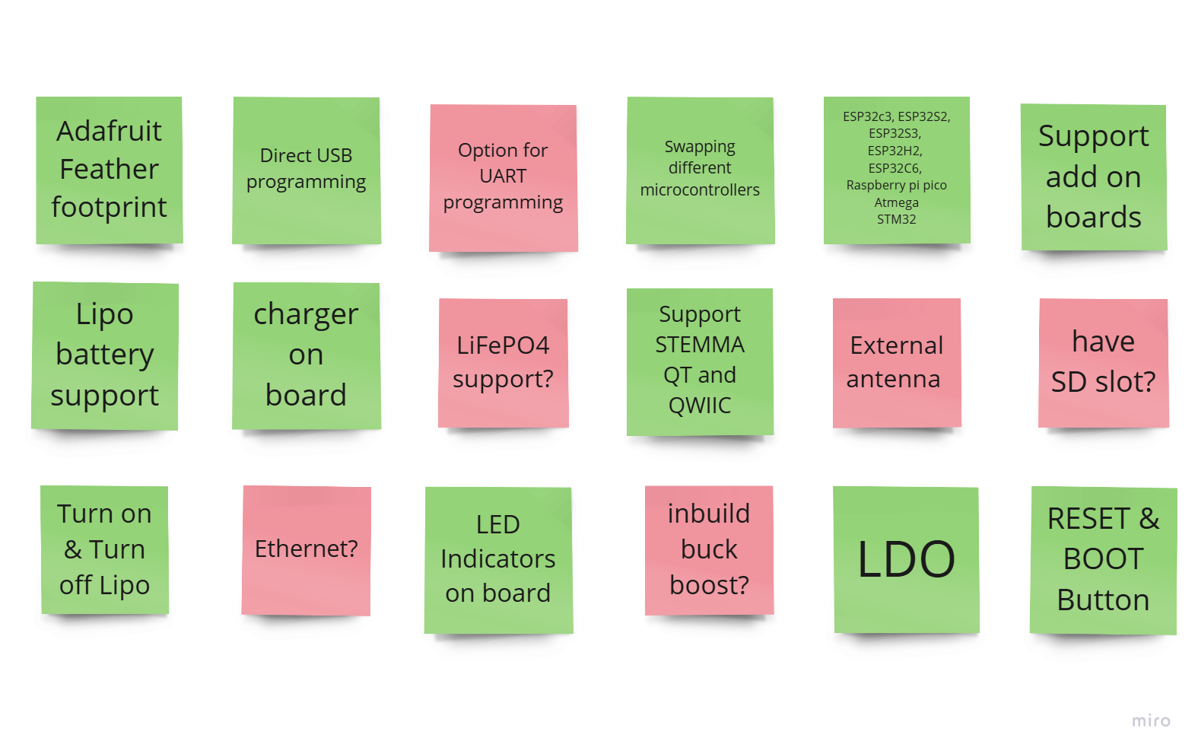
Feature Breakdown

Slide 12
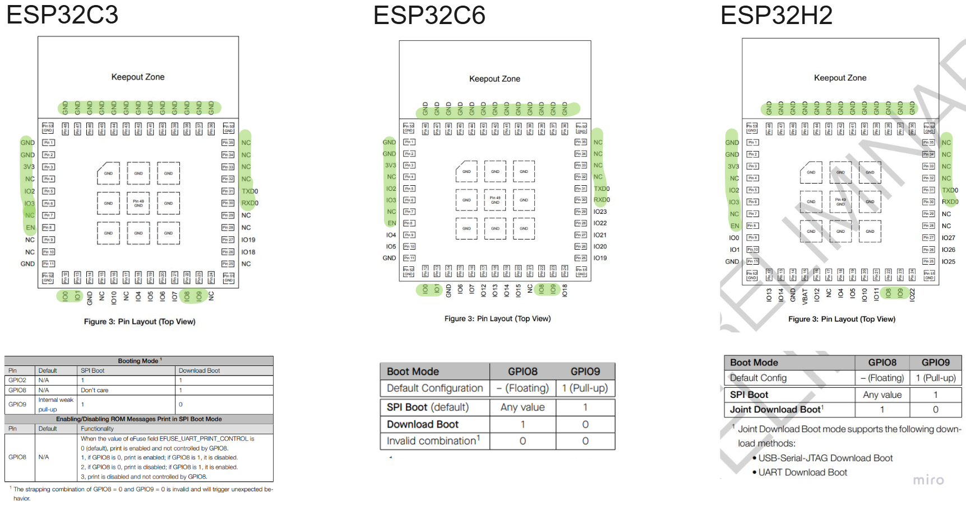
Parts Selection – #Secret 1

Slide 13
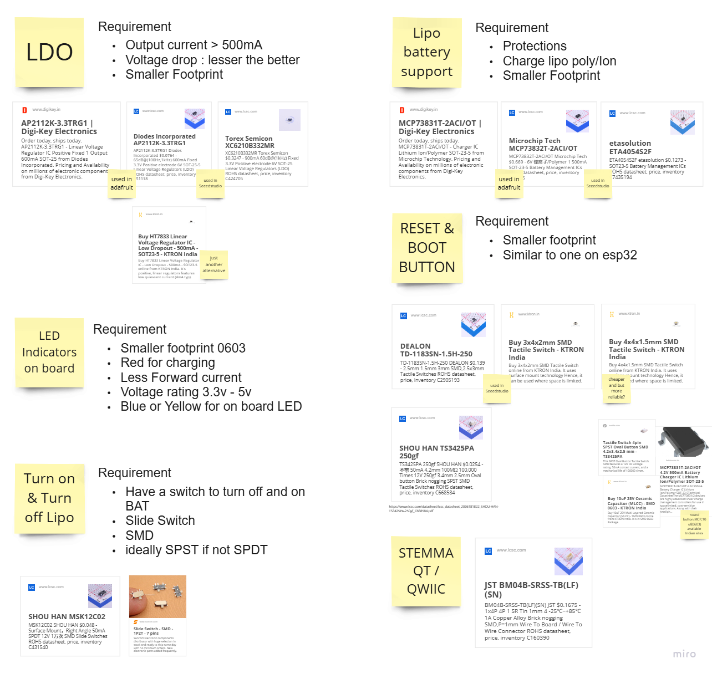

https://www.youtube.com/watch?v=0gfi7CeLzbg

Slide 14
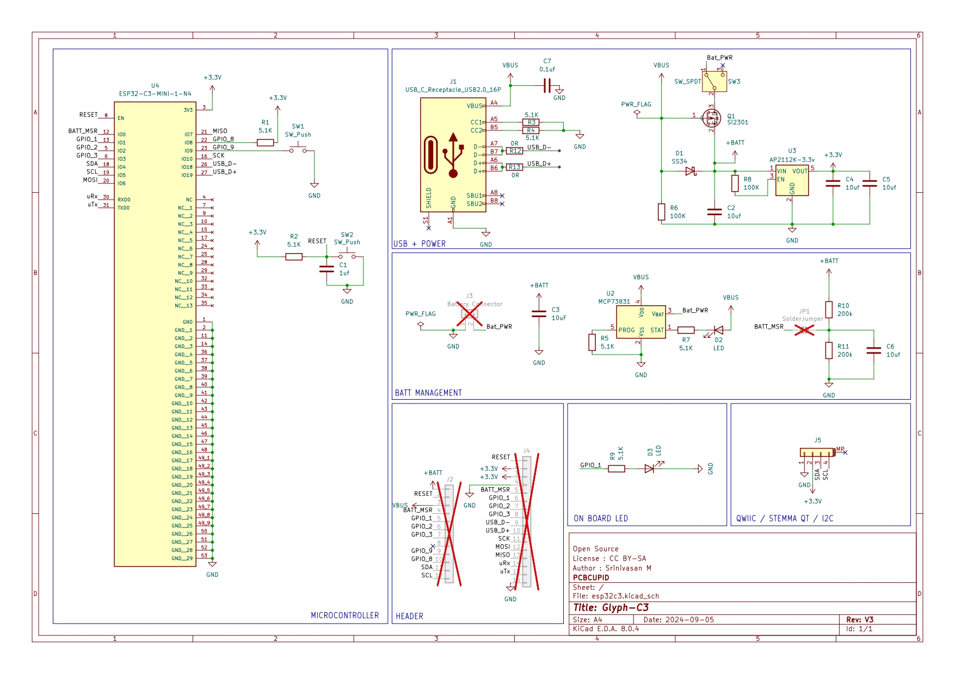
Design Optimization – #Secret 2

Slide 15
Design Optimization in GLYPH
Drop in Replacement
Used Commonly available parts
Placement of the components on the same location
Try to use same passive throughout the circuit
Try to use The hardware feature to fullest – Push things to firmware!

Slide 16
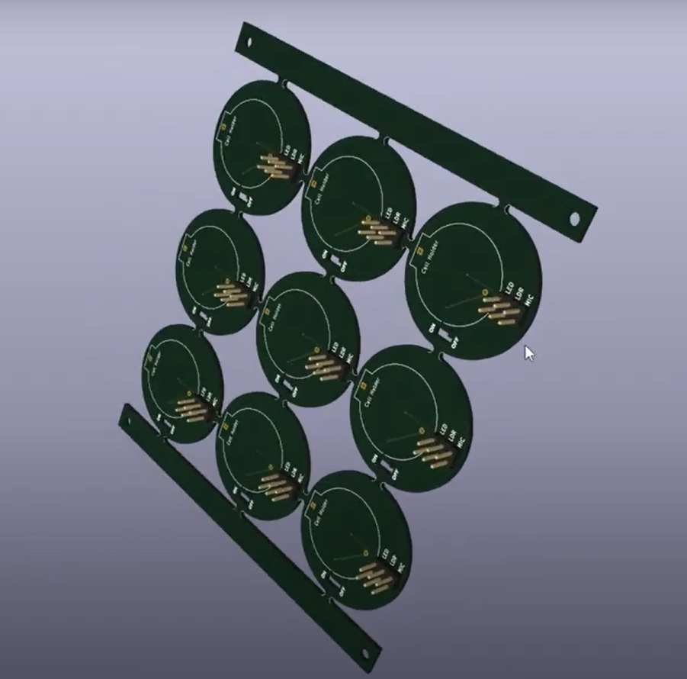

DO THIS SAVE MORE!! - #Secret 3
https://www.youtube.com/watch?v=OwbWVQkONH4

Slide 17
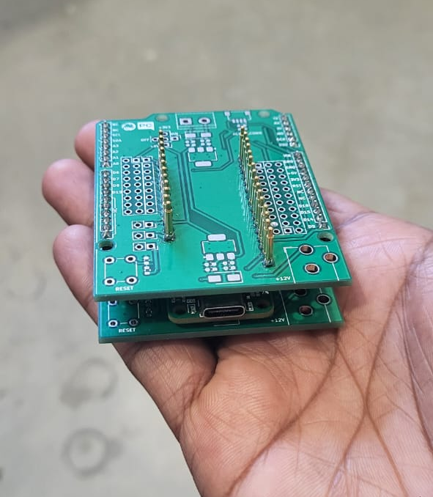
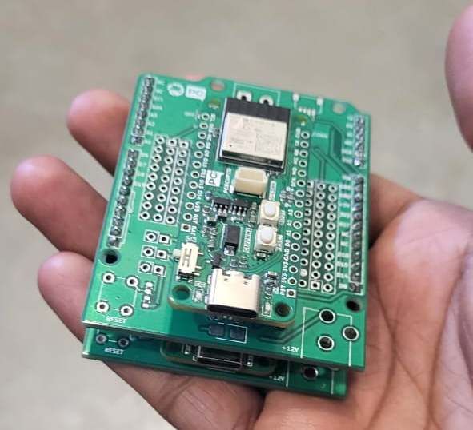
AUTOMATE EVERYTHING #Secret 4

Slide 18
Finding Manufacturer #Secret 5
FABRICATION
PROCURMENT
ASSEMBLY
TESTING

Slide 19
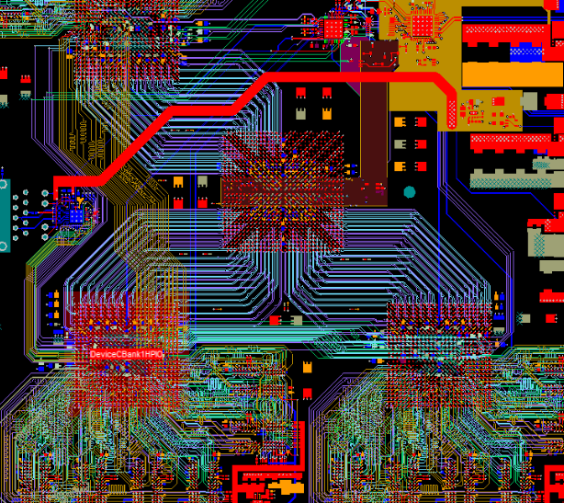
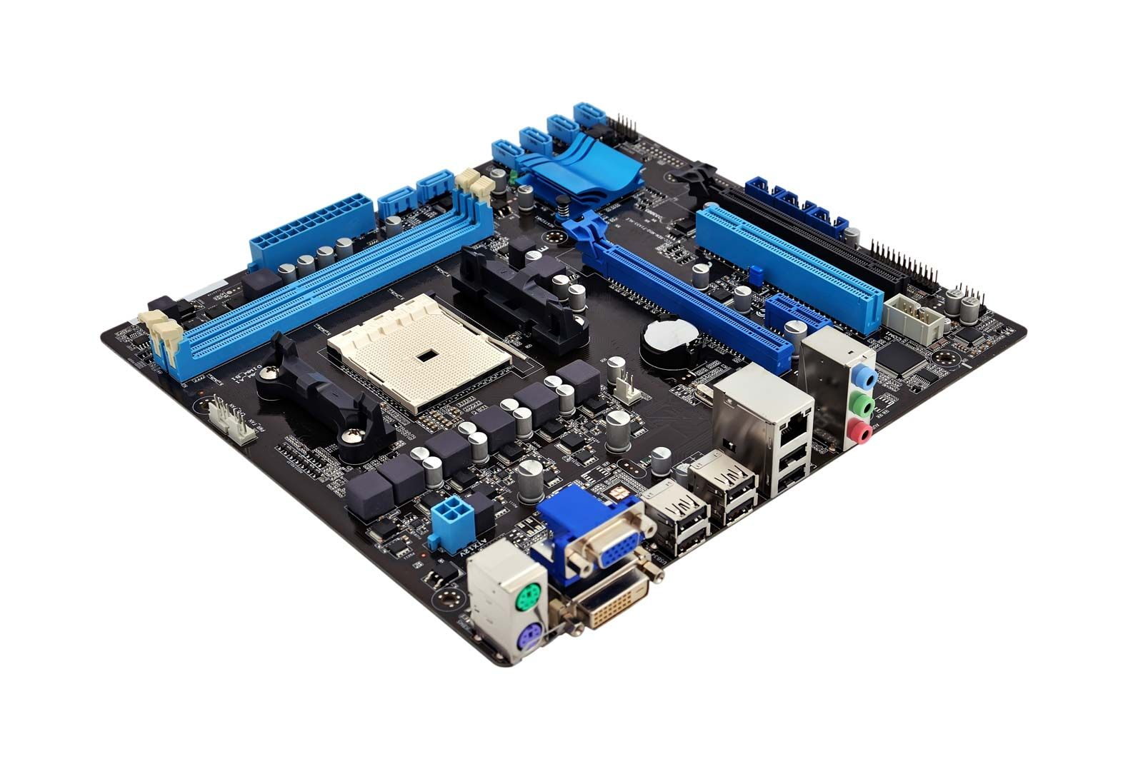
JOB MARKET &
SCOPE FOR PCB / PRODUCT DESIGN

Slide 20
THANK YOU!!

